Slide 1
Image and Text
Rendering both on the same slide

Slide 2
Recommendation
By default, images render on their own slide. If you want to put image and text on the same slide try these options:
Use a caption
Use columns

Slide 3
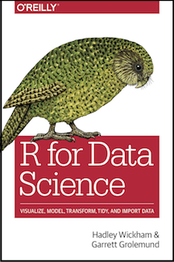
R for Data Science
Data science is an exciting discipline that allows you to turn raw data into understanding, insight, and knowledge. The goal of “R for Data Science” is to help you learn the most important tools in R that will allow you to do data science.

Slide 4
R for Data Science
Data science is an exciting discipline that allows you to turn raw data into understanding, insight, and knowledge. The goal of “R for Data Science” is to help you learn the most important tools in R that will allow you to do data science.

